Slide 1
Lecture 4: Overview
Value Stream Mapping
Present State Map
Process Improvement Strategies
Takt Time
Future State Value Stream Map

Slide 2
Value Stream Mapping
Helps us see where value is created, and where waste exists:
Developed by ‘product family’
Shows flow of both material & information.
Helps us ‘see’ where/how specific Lean tools can be used to improve flow and eliminate waste
Consists of two types of maps: Present State (“how it is”) Future State (“how it should be”)

Slide 3
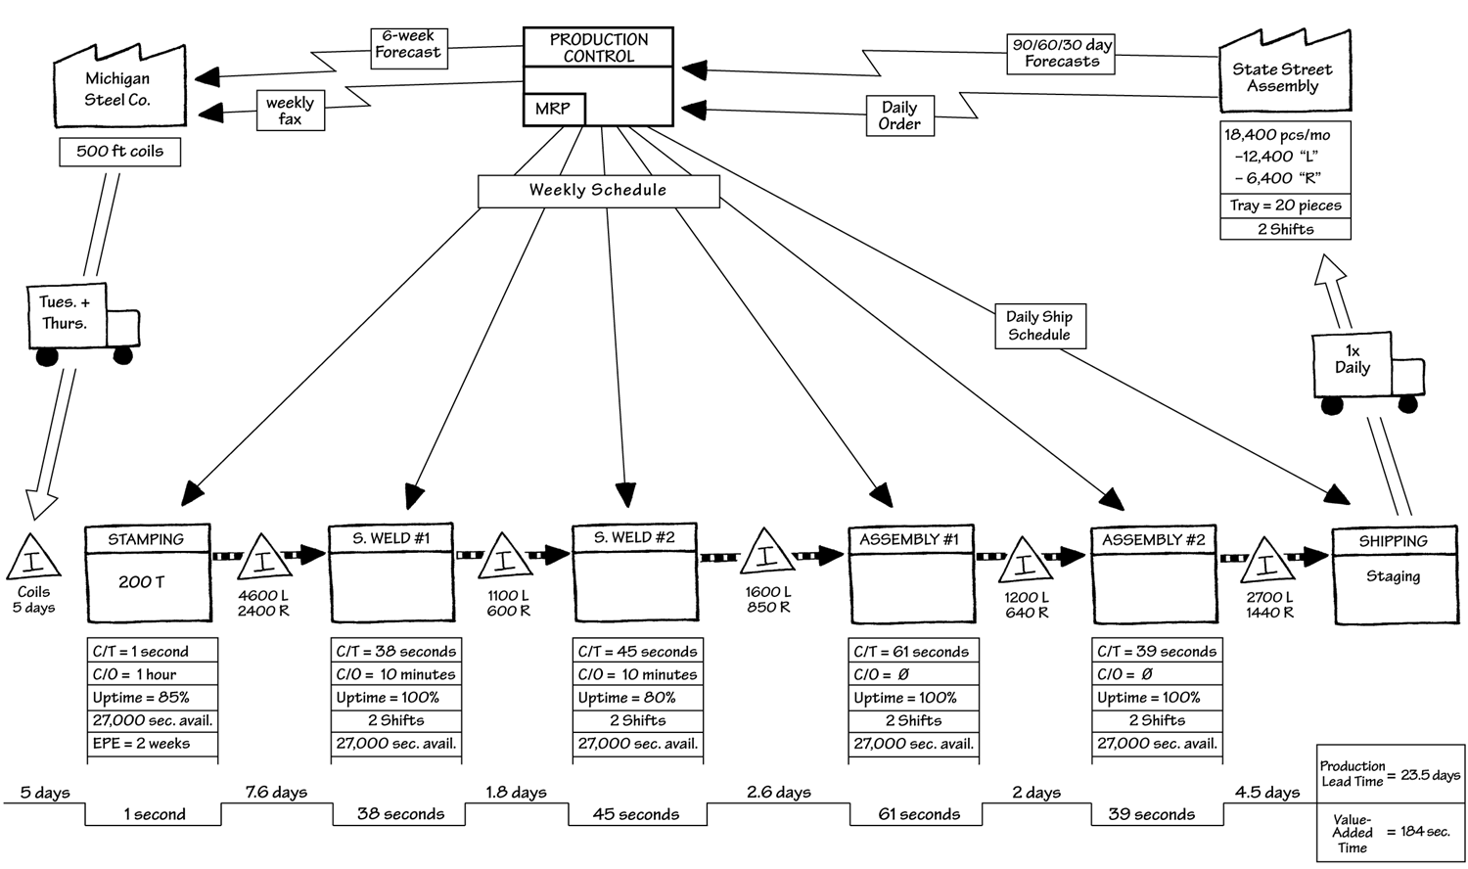
Present State Value Stream Map

Slide 4
The Process Box
Indicates basic production process.
One box for each major material flow, not for each processing step.
Process disconnection and inventory accumulation are indicators of where processes are separated.

Slide 5
The Data Box
The Data Box stores process information
Cycle Time (C/T). Rate at which a part or product is completed by a process.
Changeover Time (C/O). Amount of time to switch from one product type to another.
Uptime. Measure of machine use (100% = Always running).
Every Part Every (EPE). Measure of batch sizes and changeover cycles.
Available Work Time. Per shift of a process (in seconds, minus break, meeting, and cleanup times.)
Quality Level. % First time yield.
Number of Operators. Required personnel for a process.

Slide 6
Inventory Triangle and Push Movement Arrow
An Inventory Triangle captures the location and amount of inventory
A striped arrow indicates a Push movement of inventory according to a predefined schedule

Slide 7
Lead Time Bars
Lead time indicates total time for a process or series of process.
Production/Manufacturing Lead Time (MLT). Lead time through entire production.
Process Lead Time. Lead time though each process, including time in inventory. Calculated as inventory quantity divided by daily customer requirement.
Processing Time = Value Added Time. Actual time spent processing the part or product.
Used to highlight inefficiencies
(7000 pcs)/(28400 pcs/month)x(20 workdays/month)

Slide 8
Present State Value Stream Map

Slide 9
Map Features
1: Document customer demand
2: Define processes w/operation data
3: Show material flow
4: Show information flow
5: Compute lead times

Slide 10
Questions – Part 1
Are there any symbols on the map that you don’t recognize?
What determines the work schedule at each station?
How is ‘time’ data in the map acquired?
What is the bottleneck in the ACME manufacturing process?
Where is the biggest changeover time? What does this mean for downstream processes?

Slide 11
Questions – Part 2
What is the manufacturing lead time for a product (definition and value)? How does that compare to the value added time?
What is the impact of 1 truck a day leaving with finished goods and trucks arriving on Tuesday and Thursday with coils of steel?

Slide 12
Questions – Part 3
Where do you see waste in this process and what types of waste from the mnemonic CLOSED MITT do you see?
What countermeasures could be taken to reduce the most significant forms of waste?

Slide 13
Mapping Methodology
Focus on a product family within single plant.
Seek leadership from the value stream manager.
Go and see. Conduct door-to-door process walk.
Work backwards, starting at the shipping door.
Capture and quantify basic operations involved.
Encourage participation of all stakeholders.
Use pencil & paper rather than CAD.

Slide 14
Investigation Etiquette
Get management approval
Communicate to all areas before visit
Make introductions when you get there
Remember, the workers are the experts for their tasks!
Respect people’s work space
Explain your purpose

Slide 15
Strategies for Process Improvement
#1: Produce to your Takt Time.
#2: Develop continuous flow where possible to reduce inventory. Eliminate isolated islands of production.
#3: Use supermarkets to control production where continuous flow does not extend upstream (often outside the plant).
#4: Try to send customer schedule to only one production process (pacemaker).
#5: Load-level production at pacemaker.
#6: Release/withdraw small, consistent increments of work to pacemaker (pitch).

Slide 16
Establish Takt Time
Synchronizes pace of production to match pace of sales.
Takt Time = Demand Rate
Takt Time =
Work Time Available
Number of Units Sold
900 Seconds
85 Boards
= 10.6 Sec/Board
Takt Time =
Cycle Time
Takt Time
= Minimum # of People
GOAL: Produce to Demand

Slide 17
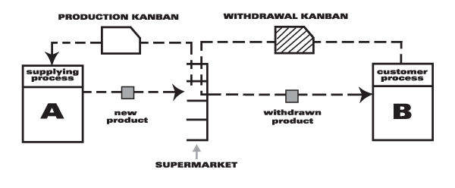
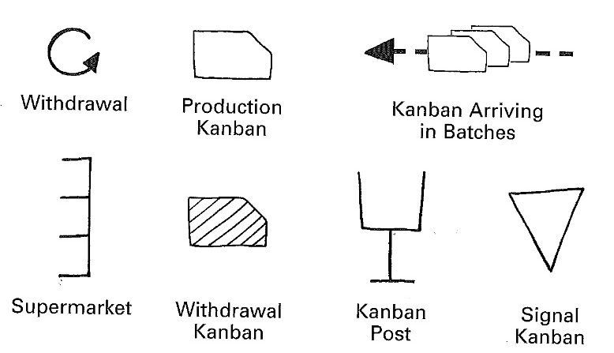
Supermarket Pull System
Used to control production where continuous flow does not extend upstream.
Example Reasons for Supermarkets:
Process that operate at very fast or slow cycle times and need to change over to serve multiple product families
Some processes, such as those at suppliers, are far away and shipping one piece at a time does not make sense.
Some processes have too much lead time or are too unreliable to couple directly to other processes in a continuous flow.

Slide 18
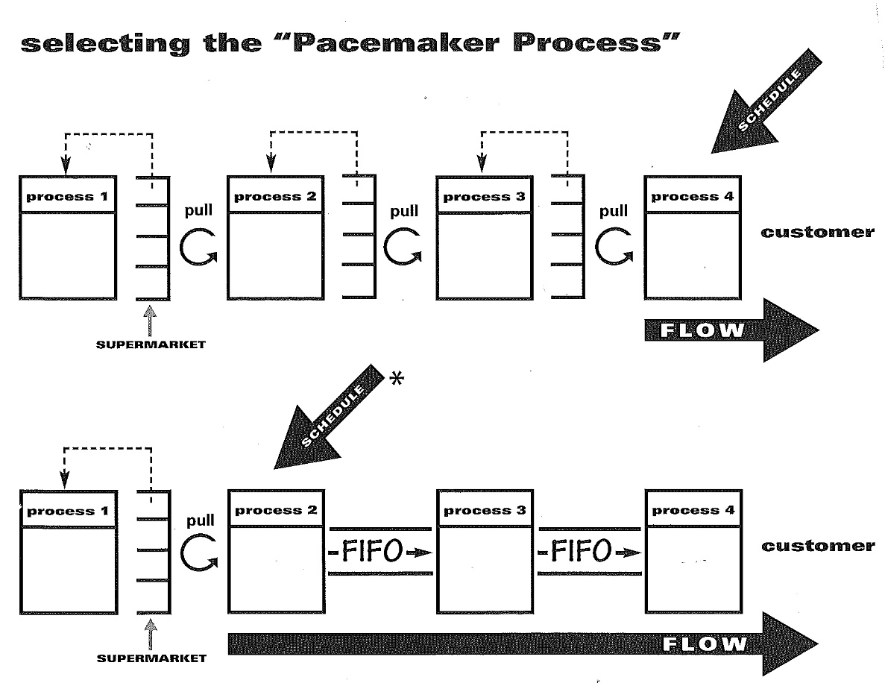
Pacemaker Process
A pacemaker process is single point in the manufacturing value stream that sets the production pace for the entire process.
The pacemaker process is frequently the most downstream continuous-flow process.
On the future-state map, the pacemaker process is the production process that is controlled by the outside customer’s orders.
Load-leveling means distributing the production of different products evenly over a time period, creating a product “mix”.
The schedule should create an “initial pull” by releasing and withdrawing a small, consistent increment of work, called the “Pitch”.

Slide 19
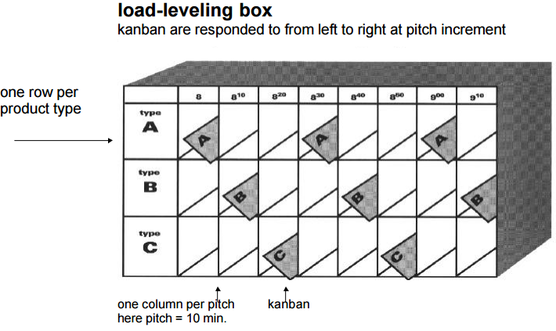
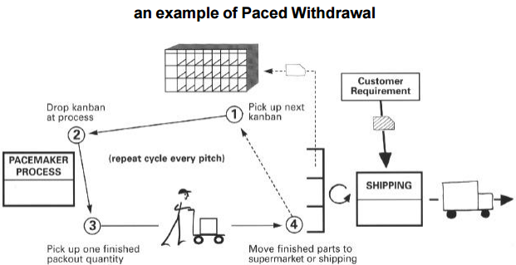
Load Leveling and Paced Withdrawl
Load-leveling means distributing the production of different products evenly over a time period, creating a product “mix”.
The schedule should create an “initial pull” by releasing and withdrawing a small, consistent increment of work, called the “Pitch”.

Slide 20
Questions – Part 4
What is the company’s Takt time if the demand is 460 parts per 8 hour shift (with two 10 minute breaks)?
Where is it not practical to achieve continuous flow? How could a supermarket be used to overcome this?
How can the welding and assembly operations be configured to Takt time?
What should be the pacemaker process?
What other improvements are possible?

Slide 21
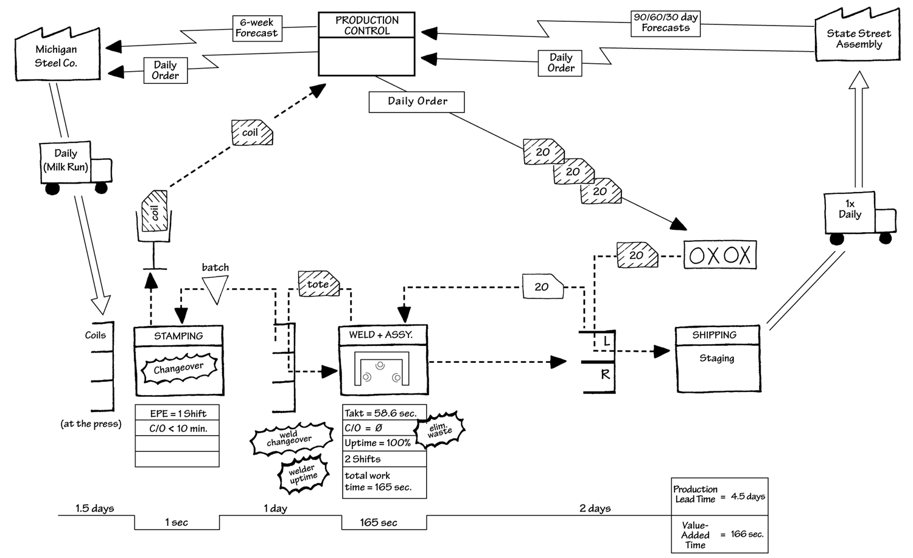
Future State Value Stream Map

